Slide 1


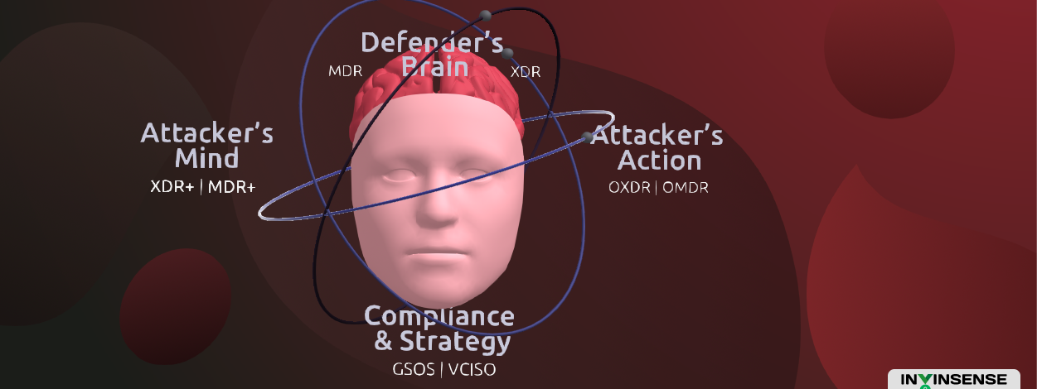
Kubernetes on-premise installation process
Cybersecurity with an attacker’s mind and a defender’s brain

Slide 2

Agenda
Script-overview
Practical-demo
doubts

Slide 3
Script Overview:
Script having – 5 files
  Master-prerequisite.sh
  Worker-prerequisite.sh
  Dynamic-allrounder.sh
  Master-removal.sh
  Woker-installation.sh
  Worker-removal.sh
Installation method
  firstly we need to run Worker-prerequisite.sh on both worker nodes
  Secondly run the Master-prerequisite.sh
  Thirdly we need to copy 4 remains files (Dynamic-allrounder.sh ,Master-removal.sh, Woker-installation.sh and Worker-removal.sh )
  And give all files execute permission

Slide 4
Questions and answers

